Slide 1
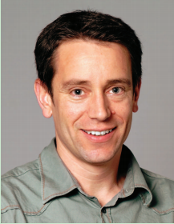
Y²Seq2Seq: Cross-Modal Representation Learning for 3D Shape and Text by Joint Reconstruction and Prediction of View and Word Sequences
Zhizhong Han
1,2
1
1
1
2
Mingyang Shang
Xiyang Wang
Yu-Shen Liu
Matthias Zwicker
1
School of Software, Tsinghua University, Beijing, China
2
Department of Computer Science, University of Maryland, College Park, USA

Slide 2
Content
Background
Motivation
Current solution
The key idea of Y²Seq2Seq
Problem statement
Technical details
Results
Contributions

Slide 3
Background
With the development of 3D modeling and scanning techniques, more and more 3D shapes become available on the Internet with detailed physical properties, such as texture, color, and material.
With large 3D datasets, however, shape class labels are becoming too coarse of a tool to help people efficiently find what they want, and visually browsing through shape classes is cumbersome.

Slide 4
Motivation
To alleviate this issue, an intuitive approach is to allow users to describe the desired 3D object using a text description.
Jointly understanding 3D shape and text by learning a cross-modal representation, however, is still a challenge because it requires an efficient 3D shape representation that can capture highly detailed 3D shape structures.

Slide 5
Current solution
A 3D-Text cross-modal dataset was recently released, where a combined multimodal association model was also proposed to capture the many-to-many relations between 3D voxels and text descriptions.
However, this strategy is limited to learning from low resolution voxel representations due to the computational cost caused by the cubic complexity of 3D voxels.
This leads to low discriminability of learned cross-modal representations due to a lack of detailed geometry information.

Slide 6
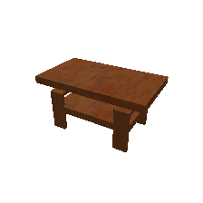
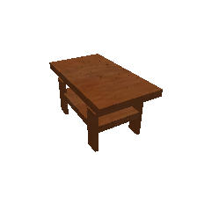
The key idea of Y²Seq2Seq
We resolve this issue by proposing to learn cross-modal representations of 3D shape and text from
View sequences, where each 3D shape is represented by a view sequence.
Word sequences, where each sentence is represented by a word sequence.
Our deep learning model captures the correlation between 3D shape and text by simultaneously
Reconstructing each modality itself
And, predicting one modality from the other.
……
A two layer table with four legs
Reconstruction
A two layer table with four legs
Reconstruction
……
Prediction
Prediction
……
A two layer table with four legs

Slide 7
Problem statement
Jointly earn the feature of a 3D shape s and the feature of a sentence t describing s.
S:
……
t:
A two layer table with four legs
Y²Seq2Seq
Fs
Ft

Slide 8
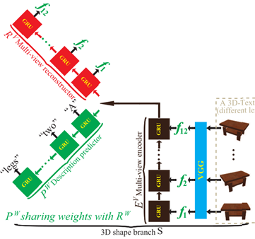
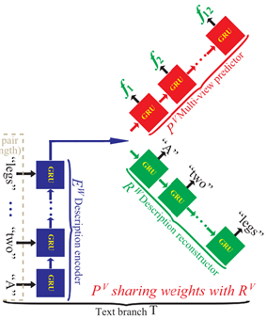
Technical details
Y²Seq2Seq is formed by two branches:
A 3D shape branch S
A text branch T
Each branch is a “Y” like seq2seq model which is formed by:
One RNN encoder
Two RNN decoders
The encoder output in each
branch is the learned features
of 3D shape and text.

Slide 9
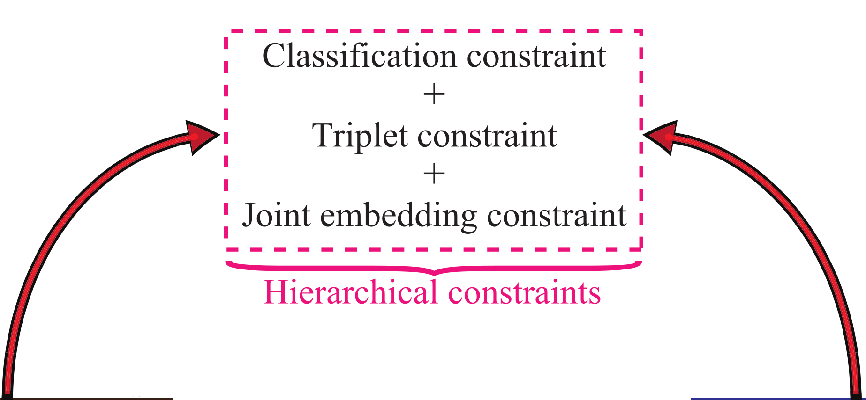
Technical details
Hierarchical constraints are further proposed to increase the discriminability of learned features.
Class level: Classification constraint
Instance pair level: Triplet constraint
Instance level: Joint embedding constraint
Two “Y” like Seq2Seq are coupled
3D reconstructor and 3D predictor
are sharing parameters.
Text reconstructor and text predictor
are sharing parameters.

Slide 10
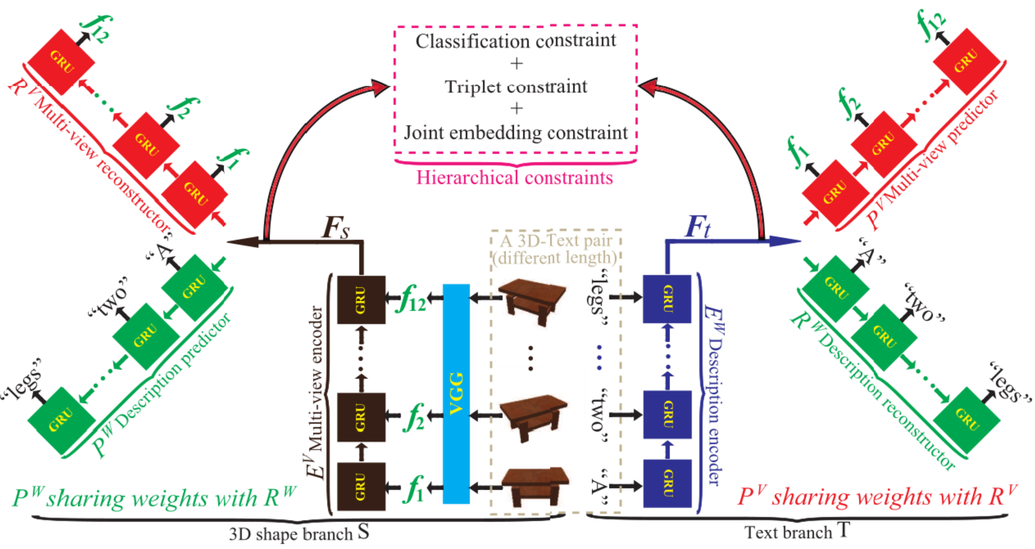
Technical details
3D shape branch S
3D to 3D reconstruction
3D to text prediction
Total losses
In feature space
α and β control the balance between the two losses.

Slide 11
Technical details
Text branch T
Text to text reconstruction
Text to 3D prediction
Total losses
ϒ and δ control the balance between the two losses.

Slide 12
Technical details
Hierarchical constraints
Class level
Instance pair level
Instance level
Total losses
Φ, ϕ and ψ control the balance between the two losses.

Slide 13
Technical details
Objective function

Slide 14
Results
Experimental evaluation in
Cross-modal retrieval, from 3D to text and from text to 3D.
3D shape captioning.
3D-Text cross-modal dataset
Primitive subset, 7560 shapes and 191850 descriptions (Primitive class).
ShapeNet subset, 15038 shapes and 75344 descriptions (Chair class and Table class).

Slide 15
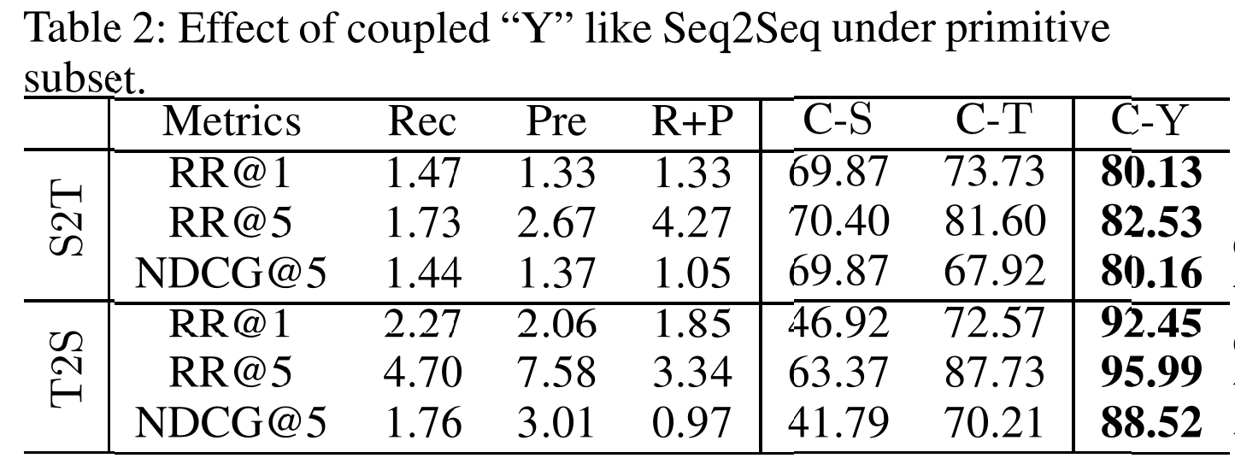
Results
Effect of coupled “Y” under primitive subset

Slide 16
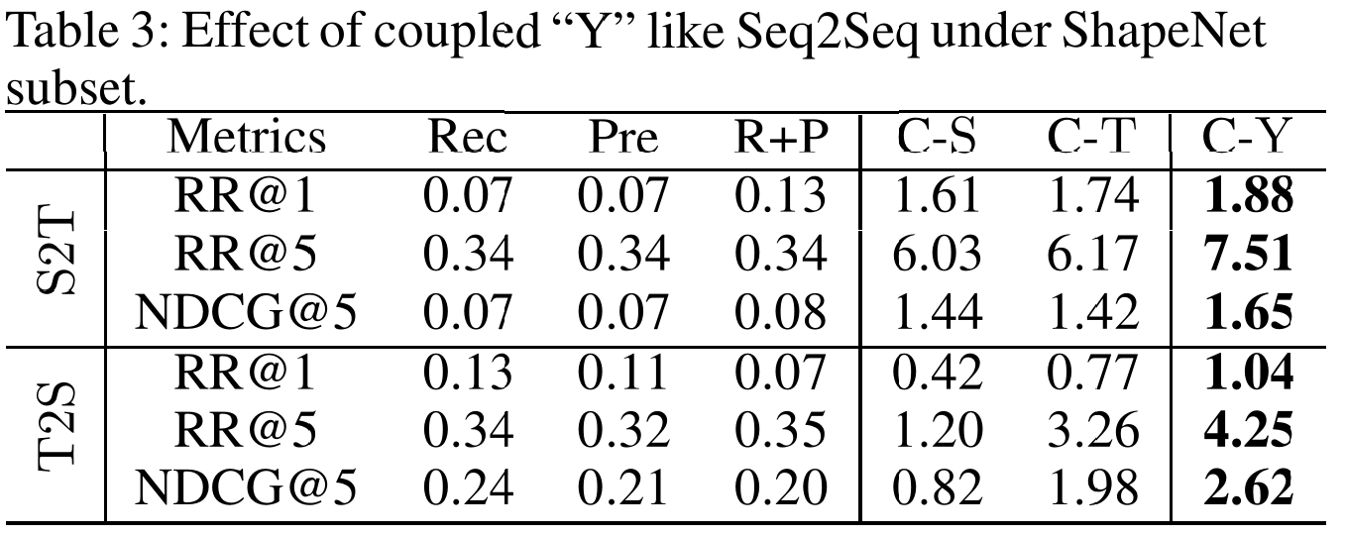
Results
Effect of coupled “Y” under ShapeNet subset

Slide 17
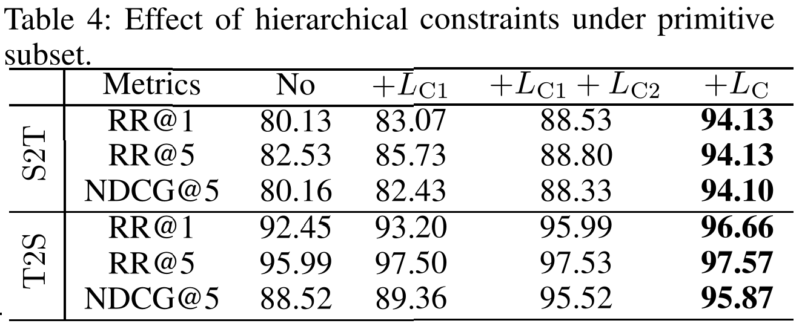
Results
Effect of hierarchical constraints under primitive subset

Slide 18
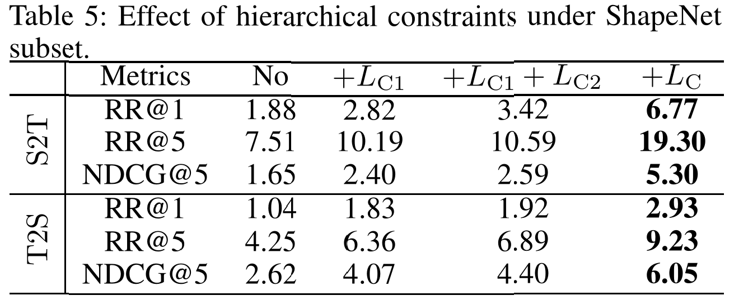
Results
Effect of hierarchical constraints under ShapeNet subset

Slide 19
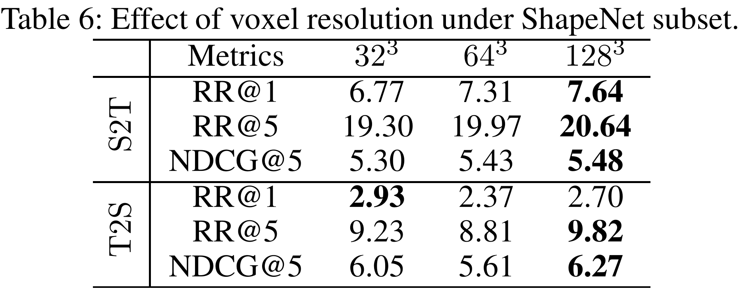
Results
Effect of voxel resolution under ShapeNet subset

Slide 20
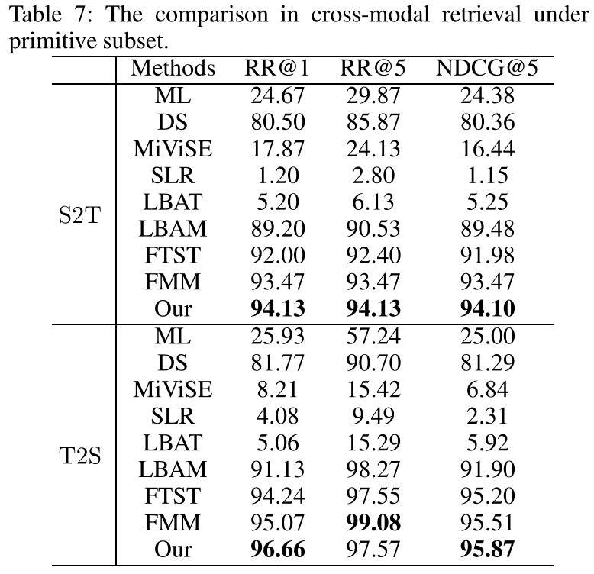
Results
Cross-modal retrieval
under primitive subset

Slide 21
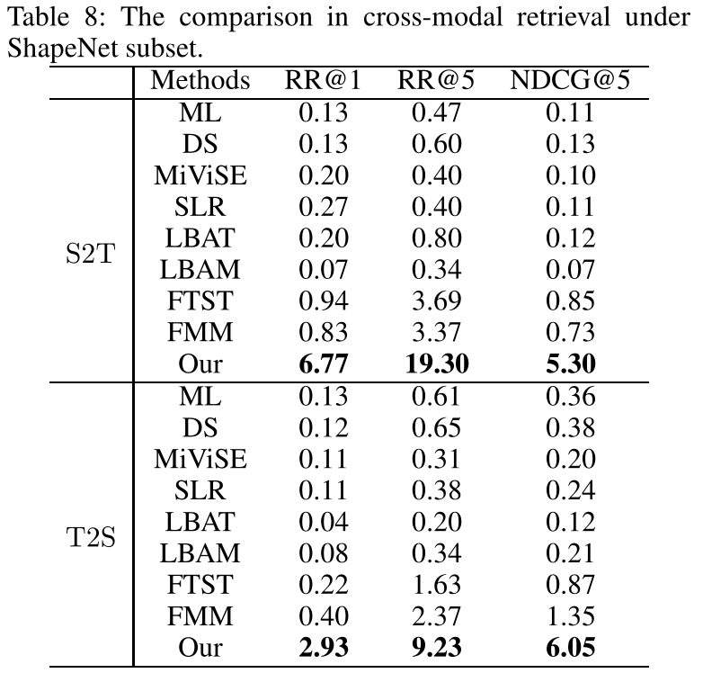
Results
Cross-modal retrieval
under ShapeNet subset

Slide 22
Results
Cross-modal retrieval visualization

Slide 23
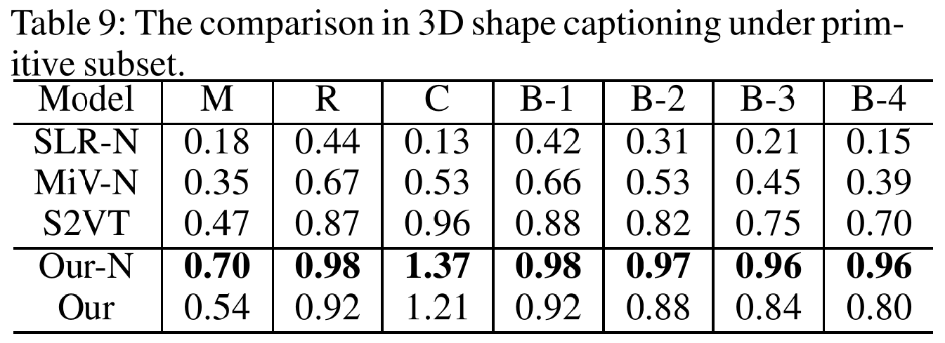
Results
3D shape captioning under primitive subset

Slide 24
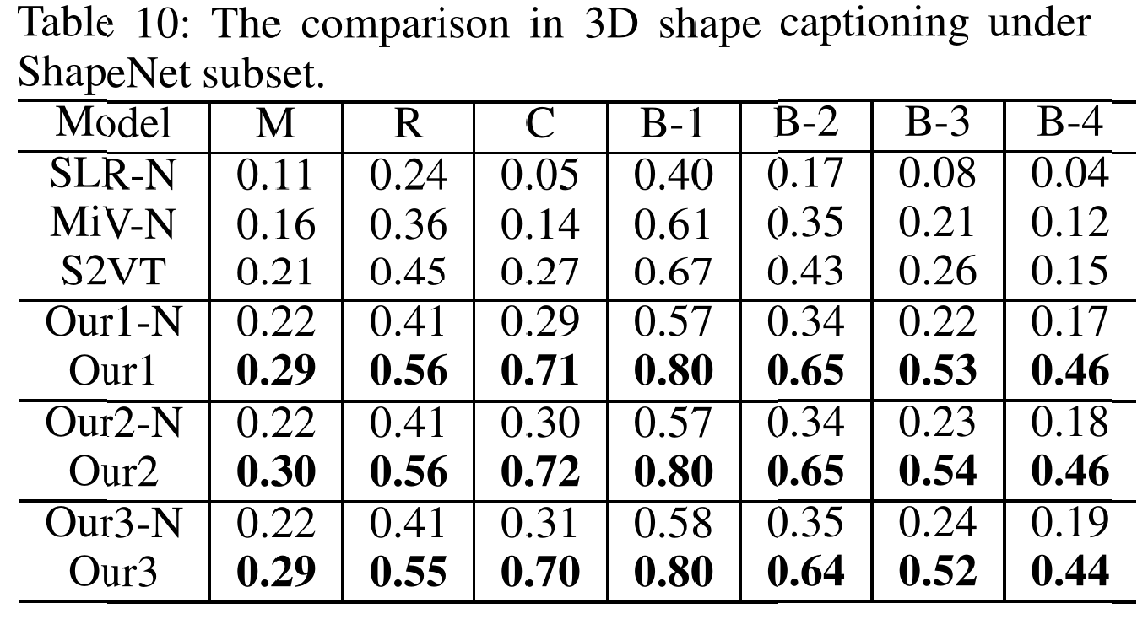
Results
3D shape captioning under ShapeNet subset

Slide 25
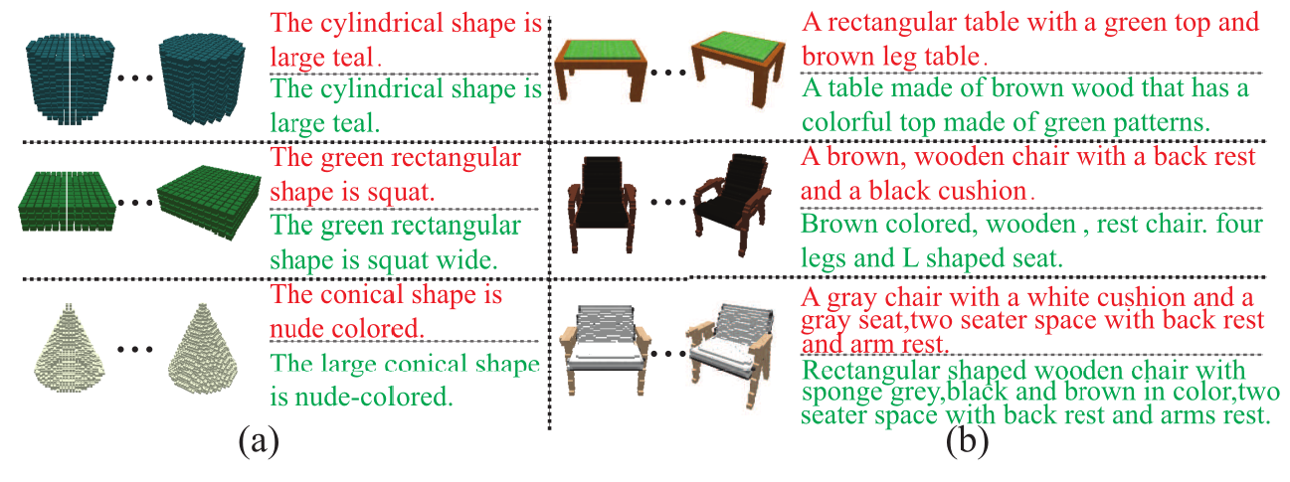
Results
3D shape captioning visualization

Slide 26
Contributions
We propose a deep learning model called Y2Seq2Seq, which enables to learn cross-modal representations of 3D shape and text from view sequences and word sequences.
Our novel coupled “Y” like Seq2Seq structures have a powerful capability to bridge the semantic meaning of two sequence-represented modalities by joint reconstruction and prediction.
Our results demonstrate that our novel hierarchical constraints can further increase the discriminability of learned cross-modal representations by employing more detailed discriminative information.

Slide 27
Thank you!

